Slide 1
SupportPilot – AI Ticket Resolution Agent – Milestone - 3

Slide 2
3. AI Resolution Generator
• Generate contextual troubleshooting recommendations.
• Provide step-by-step resolution workflows.
• Draft automated responses for end users.
4. Multi-Agent Resolution Framework
• Utilize specialized agents for diagnosis, retrieval, and response generation.
• Coordinate multiple agents for complex support scenarios.
• Automate resolution validation and confidence scoring.

Slide 3
Milestone 3 (Weeks 5–6) – Multi-Agent Workflows & Integrations
• Develop multi-agent architecture for issue resolution.
• Integrate Jira for ticket management.
• Implement email automation for support communications.

Slide 4
Milestone 3: Multi-Agent Workflows & Integrations — Python Implementation
SupportPilot AI Ticket Resolution Agent where several specialized AI agents collaborate to diagnose, retrieve knowledge, generate a resolution, validate confidence, and escalate difficult tickets.
It also integrates with Jira and email automation.

Slide 5
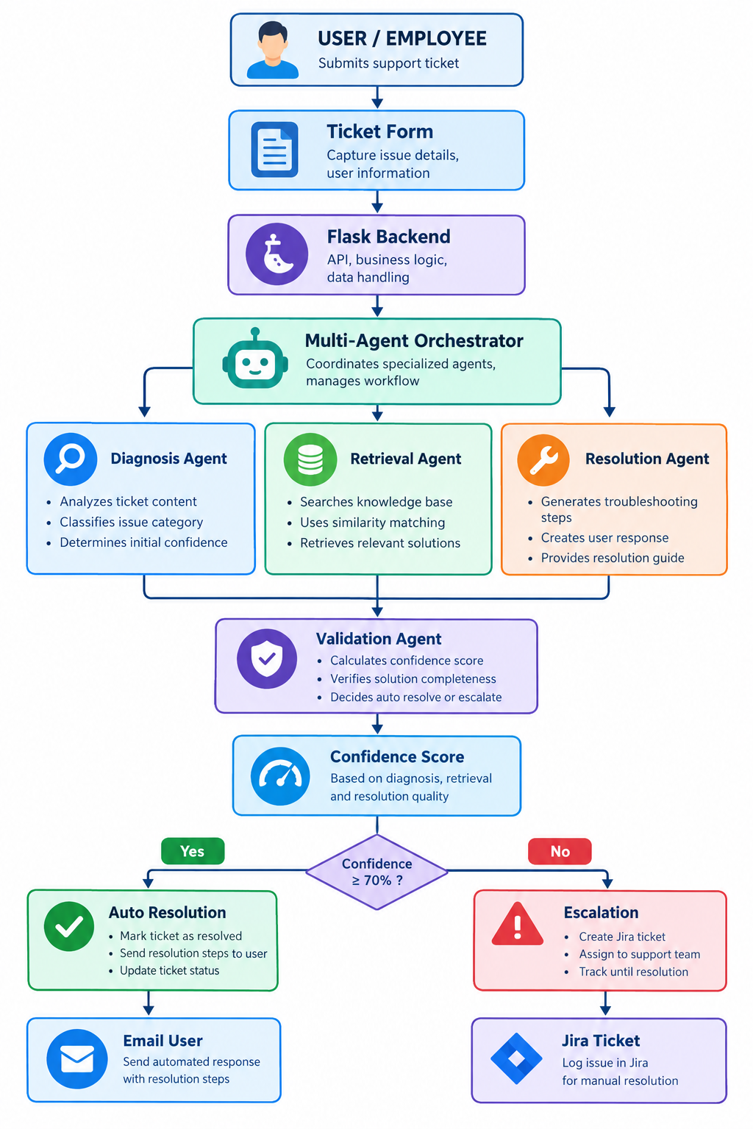
Milestone 3 – Overall Objective

Slide 6
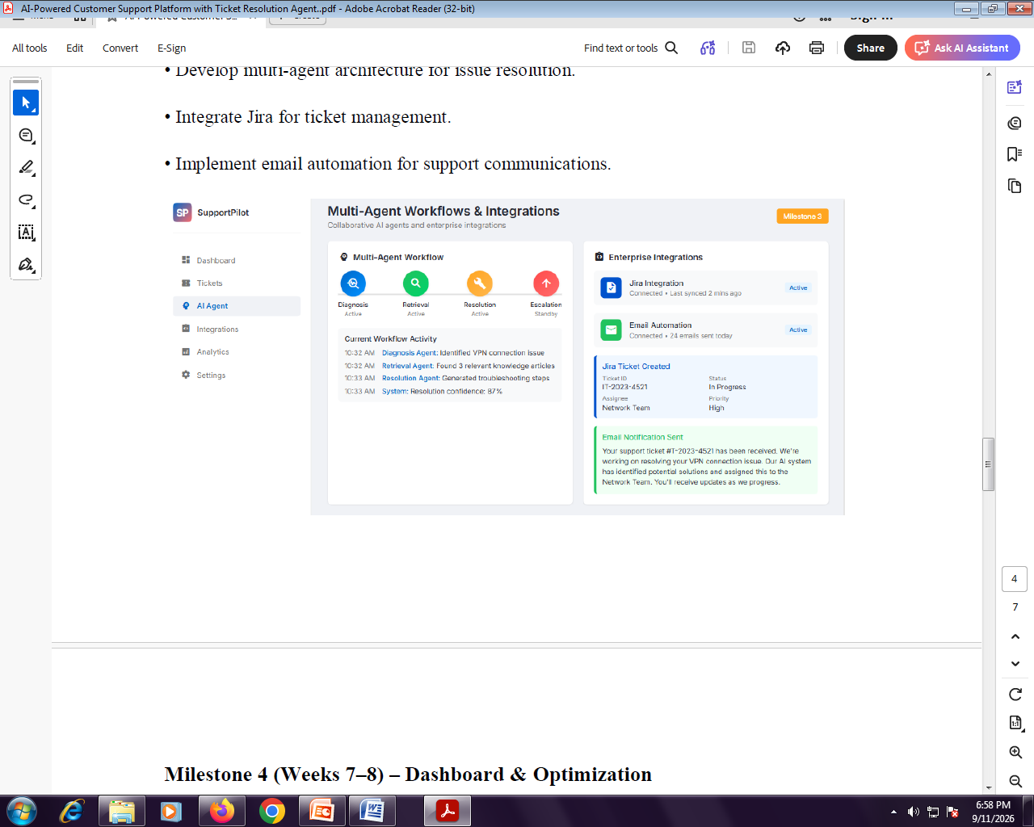

Slide 7
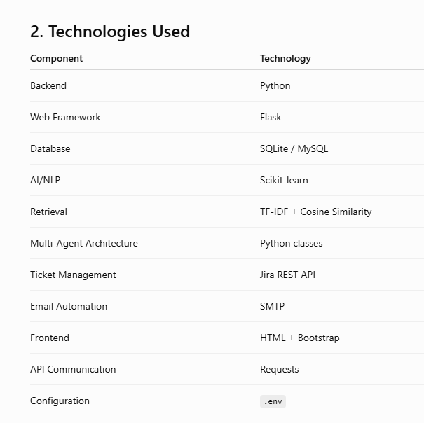
2. Technologies Used

Slide 8
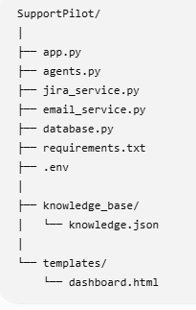
3. Project Structure
Create the following project:

Slide 9
4. Install Required Libraries
Create requirements.txt:
Flask
requests
python-dotenv
scikit-learn
Install:
pip install -r requirements.txt

Slide 10
5. Knowledge Base
Create:
knowledge_base/knowledge.json
with:
[
{
"id": 1,
"title": "VPN Connection Troubleshooting",
"content": "Check internet connectivity. Restart the VPN client. Verify username and password. Clear VPN cache. Restart the computer. If the VPN still fails, check firewall and network configuration."
},
{
"id": 2,
"title": "Password Reset",
"content": "Open the company password portal. Select Forgot Password. Verify employee identity. Enter a new password. Confirm the password and login again."
},
{
"id": 3,
"title": "Email Not Working",
"content": "Check internet connectivity. Verify mailbox storage. Restart Outlook. Remove and re-add the email account. Check SMTP and IMAP settings."
},
{
"id": 4,
"title": "Printer Not Printing",
"content": "Check printer power and network connection. Verify printer status. Clear the print queue. Restart the print spooler. Reinstall the printer driver if required."
},
{
"id": 5,
"title": "Slow Computer",
"content": "Restart the computer. Check CPU and memory usage. Close unnecessary applications. Remove temporary files. Check available disk space. Run antivirus scanning."
}
]
This acts as the Retrieval Agent's knowledge repository.

Slide 11
6. Multi-Agent Implementation
Create agents.py.
import json
import re
from sklearn.feature_extraction.text import TfidfVectorizer
from sklearn.metrics.pairwise import cosine_similarity
# =========================================================
# KNOWLEDGE BASE
# =========================================================
with open("knowledge_base/knowledge.json", "r", encoding="utf-8") as file:
KNOWLEDGE_BASE = json.load(file)

Slide 12
# =========================================================
# 1. DIAGNOSIS AGENT
# =========================================================
class DiagnosisAgent:
def analyze(self, ticket):
text = ticket.lower()
if any(word in text for word in
["vpn", "network", "internet", "connection"]):
category = "Network / VPN"
elif any(word in text for word in
["password", "login", "authentication"]):
category = "Authentication"
elif any(word in text for word in
["email", "outlook", "mailbox"]):
category = "Email"

Slide 13
elif any(word in text for word in
["printer", "printing", "print"]):
category = "Printer"
elif any(word in text for word in
["slow", "performance", "cpu", "memory"]):
category = "Performance"
else:
category = "General IT Issue"
return {
"category": category,
"diagnosis": f"Ticket classified as {category}",
"confidence": 0.80
}

Slide 14
# =========================================================
# 2. RETRIEVAL AGENT
# =========================================================
class RetrievalAgent:
def __init__(self):
self.documents = [
item["title"] + " " + item["content"]
for item in KNOWLEDGE_BASE
]
self.vectorizer = TfidfVectorizer(
stop_words="english"
)
self.matrix = self.vectorizer.fit_transform(
self.documents
)
def search(self, query):
query_vector = self.vectorizer.transform([query])
scores = cosine_similarity(
query_vector,
self.matrix
)[0]
best_index = scores.argmax()
return {
"article": KNOWLEDGE_BASE[best_index],
"similarity": float(scores[best_index])
}

Slide 15
# =========================================================
# 3. RESOLUTION AGENT
# =========================================================
class ResolutionAgent:
def generate(self, diagnosis, article):
category = diagnosis["category"]
if category == "Network / VPN":
steps = [
"Check internet connectivity.",
"Restart the VPN client.",
"Verify username and password.",
"Clear the VPN cache.",
"Restart the computer.",
"Check firewall and network configuration."
]

Slide 16
elif category == "Authentication":
steps = [
"Open the company password portal.",
"Select 'Forgot Password'.",
"Verify employee identity.",
"Create a new password.",
"Confirm the new password.",
"Login again."
]
elif category == "Email":
steps = [
"Check internet connectivity.",
"Verify mailbox storage.",
"Restart Outlook.",
"Remove and re-add the email account.",
"Verify email server settings."
]

Slide 17
else:
# Convert knowledge article into basic steps
sentences = re.split(
r"\. ",
article["content"]
)
steps = [
sentence.strip()
for sentence in sentences
if sentence.strip()
]
response = (
f"We identified the issue as {category}. "
"Please follow these troubleshooting steps:"
)
return {
"response": response,
"steps": steps
}

Slide 18
# =========================================================
# 4. VALIDATION AGENT
# =========================================================
class ValidationAgent:
def validate(
self,
diagnosis_confidence,
retrieval_similarity,
number_of_steps
):
# Weighted confidence calculation
confidence = (
diagnosis_confidence * 0.40
+
retrieval_similarity * 0.40
+
min(number_of_steps / 6, 1) * 0.20
)
confidence = round(
confidence * 100,
2
)

Slide 19
if confidence >= 70:
status = "AUTO_RESOLVE"
else:
status = "ESCALATE"
return {
"confidence": confidence,
"status": status
}

Slide 20
#=========================================
# 5. ESCALATION AGENT
#=========================================
class EscalationAgent:
def should_escalate(self, validation):
return validation["status"] == "ESCALATE"

Slide 21
# =========================================================
# MULTI-AGENT ORCHESTRATOR
# =========================================================
class SupportPilot:
def __init__(self):
self.diagnosis_agent = DiagnosisAgent()
self.retrieval_agent = RetrievalAgent()
self.resolution_agent = ResolutionAgent()
self.validation_agent = ValidationAgent()
self.escalation_agent = EscalationAgent()
def process_ticket(self, ticket):

Slide 22
# ---------------------------------------
# STEP 1: DIAGNOSIS
# ---------------------------------------
diagnosis = self.diagnosis_agent.analyze(ticket)
# ---------------------------------------
# STEP 2: KNOWLEDGE RETRIEVAL
# ---------------------------------------
retrieval = self.retrieval_agent.search(ticket)

Slide 23
# ---------------------------------------
# STEP 3: RESOLUTION GENERATION
# ---------------------------------------
resolution = self.resolution_agent.generate(
diagnosis,
retrieval["article"]
)
# ---------------------------------------
# STEP 4: VALIDATION
# ---------------------------------------
validation = self.validation_agent.validate(
diagnosis["confidence"],
retrieval["similarity"],
len(resolution["steps"])
)

Slide 24
# ---------------------------------------
# STEP 5: ESCALATION
# ---------------------------------------
escalation = self.escalation_agent.should_escalate(
validation
)
return {
"diagnosis": diagnosis,
"retrieval": retrieval,
"resolution": resolution,
"validation": validation,
"escalation": escalation
}

Slide 25
7. How the Multi-Agent System Works
The important point is that this is not one large AI function.
There are independent agents.
Agent 1 – Diagnosis Agent
Input:
My VPN is not connecting to the company network.
Output:
Category: Network / VPN
Confidence: 80%

Slide 26
Agent 2 – Retrieval Agent
The Retrieval Agent searches the knowledge base.
It uses:
TF-IDF + Cosine Similarity
For example:
User ticket: VPN is not connecting
may retrieve:
VPN Connection Troubleshooting
with:
Similarity = 0.82

Slide 27
Agent 3 – Resolution Agent
The Resolution Agent combines:
Diagnosis
+
Retrieved Knowledge
and creates:
1. Check internet connectivity.
2. Restart VPN client.
3. Verify username and password.
4. Clear VPN cache.
5. Restart computer.
6. Check firewall configuration.

Slide 28
Agent 4 – Validation Agent
The validation agent calculates:
Diagnosis Confidence = 80%
Retrieval Similarity = 82%
Resolution Completeness = 100%
and generates:
Resolution Confidence = 84.8%
Therefore:
84.8 >= 70
Result:
AUTO_RESOLVE
If confidence is low:
Confidence = 45%
then:
ESCALATE

Slide 29
8. Jira Integration
Create:
jira_service.py
import os
import requests
from requests.auth import HTTPBasicAuth
class JiraService:
def __init__(self):
self.url = os.getenv("JIRA_URL")
self.email = os.getenv("JIRA_EMAIL")
self.api_token = os.getenv("JIRA_API_TOKEN")
self.project_key = os.getenv("JIRA_PROJECT_KEY")
def create_ticket(
self,
summary,
description,
priority="High"
):

Slide 30
if not all([
self.url,
self.email,
self.api_token,
self.project_key
]):
return {
"success": False,
"message": "Jira configuration not available"
}
endpoint = (
f"{self.url}/rest/api/3/issue"
)
payload = {
"fields": {
"project": {
"key": self.project_key
},
"summary": summary,

Slide 31
"description": {
"type": "doc",
"version": 1,
"content": [
{
"type": "paragraph",
"content": [
{
"text": description,
"type": "text"
}
]
}
]
},
"issuetype": {
"name": "Task"
},
"priority": {
"name": priority
}
}
}

Slide 32
response = requests.post(
endpoint,
json=payload,
auth=HTTPBasicAuth(
self.email,
self.api_token
),
headers={
"Accept": "application/json",
"Content-Type": "application/json"
},
timeout=20
)

Slide 33
if response.status_code in [200, 201]:
data = response.json()
return {
"success": True,
"ticket_id": data.get("key"),
"message": "Jira ticket created successfully"
}
return {
"success": False,
"message": response.text
}

Slide 34
9. Jira Integration Explanation
When the AI cannot confidently resolve a ticket:
Confidence < 70%
│
▼
Escalation Agent
│
▼
Jira Service
│
▼
Jira REST API
│
▼
Create Jira Issue

Slide 35
Example:
Ticket ID: IT-2023-4521
Summary: VPN connection problem
Priority: High
Status: In Progress
Assignee: Network Team
This corresponds to the Jira Ticket Created panel in your screenshot.

Slide 36
10. Email Automation
Create:
email_service.py
import os
import smtplib
from email.mime.text import MIMEText
from email.mime.multipart import MIMEMultipart
class EmailService:
def __init__(self):
self.smtp_server = os.getenv(
"SMTP_SERVER",
"smtp.gmail.com"
)
self.smtp_port = int(
os.getenv(
"SMTP_PORT",
"587"
)
)

Slide 37
self.email = os.getenv("SMTP_EMAIL")
self.password = os.getenv("SMTP_PASSWORD")
def send_email(
self,
recipient,
subject,
body
):
if not self.email or not self.password:
return {
"success": False,
"message": "SMTP configuration missing"
}

Slide 38
message = MIMEMultipart()
message["From"] = self.email
message["To"] = recipient
message["Subject"] = subject
message.attach(
MIMEText(body, "plain")
)
try:
server = smtplib.SMTP(
self.smtp_server,
self.smtp_port
)
server.starttls()
server.login(
self.email,
self.password
)

Slide 39
server.sendmail(
self.email,
recipient,
message.as_string()
)
server.quit()
return {
"success": True,
"message": "Email sent successfully"
}
except Exception as error:
return {
"success": False,
"message": str(error)
}

Slide 40
11. Email Automation Workflow
Automatically Resolved Ticket
Ticket
│
▼
AI Diagnosis
│
▼
Knowledge Retrieval
│
▼
Resolution Generation
│
▼
Confidence = 87%
│
▼
Auto Resolution
│
▼
Email User

Slide 41
Example email:
Subject: Support Ticket Resolved
Hello,
We identified your issue as a VPN connection problem.
Please follow these steps:
1. Check your internet connection.
2. Restart the VPN client.
3. Verify your username and password.
4. Clear the VPN cache.
5. Restart your computer.
6. Check firewall configuration.
Resolution confidence: 87%.
Regards,
SupportPilot AI
This implements the Email Notification Sent section shown in the screenshot.

Slide 42
12. Flask Backend
Create:
app.py
from flask import (
Flask,
request,
jsonify,
render_template
)
from dotenv import load_dotenv
from agents import SupportPilot
from jira_service import JiraService
from email_service import EmailService
# Load .env
load_dotenv()
app = Flask(__name__)
# Initialize services
support_pilot = SupportPilot()
jira_service = JiraService()
email_service = EmailService()

Slide 43
# =========================================================
# DASHBOARD
# =========================================================
@app.route("/")
def dashboard():
return render_template(
"dashboard.html"
)
# =========================================================
# PROCESS TICKET
# =========================================================
@app.route(
"/api/ticket",
methods=["POST"]
)
def process_ticket():
data = request.get_json()
ticket = data.get(
"ticket",
""
)
user_email = data.get(
"email",
""
)
if not ticket:
return jsonify({

Slide 44
"success": False,
"message": "Ticket description required"
}), 400
# -----------------------------------------
# MULTI-AGENT PROCESSING
# -----------------------------------------
result = support_pilot.process_ticket(
ticket
)
confidence = result[
"validation"
]["confidence"]
status = result[
"validation"
]["status"]

Slide 45
# -----------------------------------------
# AUTO RESOLUTION
# -----------------------------------------
if status == "AUTO_RESOLVE":
email_result = None
if user_email:
email_body = (
result["resolution"]["response"]
+ "\n\n"
+ "\n".join(
f"{i + 1}. {step}"
for i, step
in enumerate(
result["resolution"]["steps"]
)
)
+ f"\n\nResolution confidence: "
f"{confidence}%"
)

Slide 46
email_result = email_service.send_email(
user_email,
"Support Ticket Resolution",
email_body
)
return jsonify({
"success": True,
"status": "AUTO_RESOLVE",
"confidence": confidence,
"result": result,
"email": email_result
})

Slide 47
# -----------------------------------------
# ESCALATION TO JIRA
# -----------------------------------------
jira_result = jira_service.create_ticket(
summary=result[
"diagnosis"
]["diagnosis"],
description=(
ticket
+ "\n\nAI Diagnosis: "
+ result["diagnosis"]["diagnosis"]
+ "\n\nAI Resolution:\n"
+ "\n".join(
result[

Slide 48
"resolution"
]["steps"]
)
+ f"\n\nConfidence: {confidence}%"
),
priority="High"
)
return jsonify({
"success": True,
"status": "ESCALATE",
"confidence": confidence,
"result": result,
"jira": jira_result
})

Slide 49
# =========================================================
# HEALTH CHECK
# =========================================================
@app.route("/health")
def health():
return jsonify({
"status": "running",
"service": "SupportPilot AI"
})

Slide 50
# =========================================================
# RUN APPLICATION
# =========================================================
if __name__ == "__main__":
app.run(
host="0.0.0.0",
port=5000,
debug=True
)

Slide 51
13. Dashboard
Create:
templates/dashboard.html
<!DOCTYPE html>
<html lang="en">
<head>
<meta charset="UTF-8">
<meta name="viewport"
content="width=device-width, initial-scale=1">
<title>SupportPilot AI</title>
<link
href="https://cdn.jsdelivr.net/npm/bootstrap@5.3.3/dist/css/bootstrap.min.css"
rel="stylesheet">
<style>
body {
background: #f4f6f9;
}
.sidebar {
min-height: 100vh;
background: white;
padding: 25px;
}
.agent-card {
border-radius: 15px;
padding: 20px;
background: white;
box-shadow: 0 2px 10px rgba(0,0,0,.08);
}

Slide 52
.agent-circle {
width: 55px;
height: 55px;
border-radius: 50%;
display: flex;
align-items: center;
justify-content: center;
margin: auto;
font-weight: bold;
}
.result-box {
background: #f8f9fa;
border-radius: 10px;
padding: 15px;
}
</style>
</head>
<body>

Slide 53
<div class="container-fluid">
<div class="row">
<!-- SIDEBAR -->
<div class="col-md-2 sidebar">
<h4>🟦 SupportPilot</h4>
<hr>
<p>▦ Dashboard</p>
<p>🎫 Tickets</p>
<p><b>🤖 AI Agent</b></p>
<p>🔗 Integrations</p>
<p>📊 Analytics</p>
<p>⚙ Settings</p>
</div>

Slide 54
<!-- MAIN -->
<div class="col-md-10 p-4">
<div class="d-flex
justify-content-between">
<div>
<h2>
Multi-Agent Workflows
& Integrations
</h2>
<p class="text-muted">
Collaborative AI agents
and enterprise integrations
</p>
</div>

Slide 55
<span class="badge bg-warning
text-dark p-3">
Milestone 3
</span>
</div>
<!-- AGENTS -->
<div class="row mt-4">
<div class="col-md-3">
<div class="agent-card text-center">
<div class="agent-circle
bg-primary text-white">
🔍
</div>
<h5 class="mt-3">
Diagnosis
</h5>

Slide 56
<span class="badge
bg-success">
Active
</span>
</div>
</div>
<div class="col-md-3">
<div class="agent-card text-center">
<div class="agent-circle
bg-success text-white">
🔎
</div>
<h5 class="mt-3">
Retrieval
</h5>

Slide 57
<span class="badge
bg-success">
Active
</span>
</div>
</div>
<div class="col-md-3">
<div class="agent-card text-center">
<div class="agent-circle
bg-warning">
🔧
</div>
<h5 class="mt-3">
Resolution
</h5>
<span class="badge
bg-success">
Active
</span>
</div>
</div>

Slide 58
<div class="col-md-3">
<div class="agent-card text-center">
<div class="agent-circle
bg-danger text-white">
↑
</div>
<h5 class="mt-3">
Escalation
</h5>
<span class="badge
bg-secondary">
Standby
</span>
</div>
</div>
</div>

Slide 59
<!-- TICKET FORM -->
<div class="agent-card mt-4">
<h4>
Submit Support Ticket
</h4>
<textarea
id="ticket"
class="form-control mt-3"
rows="4"
placeholder="Describe your issue...">
</textarea>
<input
id="email"
class="form-control mt-3"
placeholder="User email">

Slide 60
<button
onclick="processTicket()"
class="btn btn-primary mt-3">
Process Ticket
</button>
</div>
<!-- RESULT -->
<div
id="result"
class="agent-card mt-4">
<h4>
Current Workflow Activity
</h4>
<div
id="output"
class="result-box mt-3">
Waiting for ticket...
</div>
</div>
</div>
</div>
</div>

Slide 61
<script>
async function processTicket() {
const ticket =
document.getElementById(
"ticket"
).value;
const email =
document.getElementById(
"email"
).value;
const output =
document.getElementById(
"output"
);
output.innerHTML =
"AI agents are processing the ticket...";
const response =
await fetch(
"/api/ticket",

Slide 62
{
method: "POST",
headers: {
"Content-Type":
"application/json"
},
body: JSON.stringify({
ticket: ticket,
email: email
})
}
);
const data =
await response.json();
if (!data.success) {
output.innerHTML =
data.message;
return;
}
let html = "";
html +=
"<b>Diagnosis:</b> "
+ data.result.diagnosis.diagnosis
+ "<br><br>";

Slide 63
html +=
"<b>Resolution Confidence:</b> "
+ data.confidence
+ "%<br><br>";
html +=
"<b>Status:</b> "
+ data.status
+ "<br><br>";
html +=
"<b>Resolution Steps:</b><ol>";
data.result.resolution.steps
.forEach(function(step) {
html +=
"<li>"
+ step
+ "</li>";
});
html += "</ol>";
if (data.jira) {
html +=
"<hr><b>Jira:</b> "
+ data.jira.message;
}

Slide 64
if (data.email) {
html +=
"<hr><b>Email:</b> "
+ data.email.message;
}
output.innerHTML = html;
}
</script>
</body>
</html>

Slide 65
14. Environment Configuration
Create:
.env
Example:
# Jira
JIRA_URL=https://your-domain.atlassian.net
JIRA_EMAIL=your-email@example.com
JIRA_API_TOKEN=your-jira-api-token
JIRA_PROJECT_KEY=IT
# Email
SMTP_SERVER=smtp.gmail.com
SMTP_PORT=587
SMTP_EMAIL=support@example.com
SMTP_PASSWORD=your-app-password
Do not put real passwords, API tokens, or SMTP credentials directly into Python source code.

Slide 66
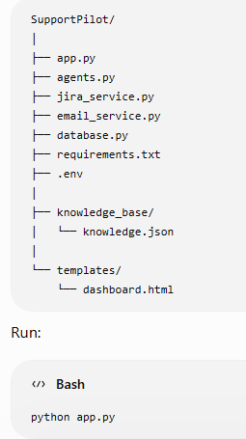
15. Running the Application
Project:

Slide 67
You should get:
* Running on http://127.0.0.1:5000
Open:
http://127.0.0.1:5000

Slide 68
16. Example Real-Time Execution
Suppose the user submits:
My VPN is not connecting to the company network.
Step 1 – Diagnosis Agent
Input:
My VPN is not connecting...
Output:
Category = Network / VPN
Confidence = 80%

Slide 69
Step 2 – Retrieval Agent
Search Knowledge Base
VPN Connection Troubleshooting Similarity = 82%
Step 3 – Resolution Agent
Generated Resolution:
1. Check internet connectivity.
2. Restart VPN client.
3. Verify credentials.
4. Clear VPN cache.
5. Restart computer.
6. Check firewall.

Slide 70
Step 4 – Validation Agent
Conceptually:
Diagnosis = 80%
Retrieval = 82%
Completeness = 100%
Final Confidence ≈ 84.8%

Slide 71
Step 5 – Decision
84.8% >= 70%
│
▼
AUTO RESOLVE
Step 6 – Email
Email Notification Sent
If instead:
Confidence = 52%

Slide 72
then:
52% < 70%
│
▼
Escalation Agent
│
▼
Jira Ticket Created
│
▼
Network / IT Team

Slide 73
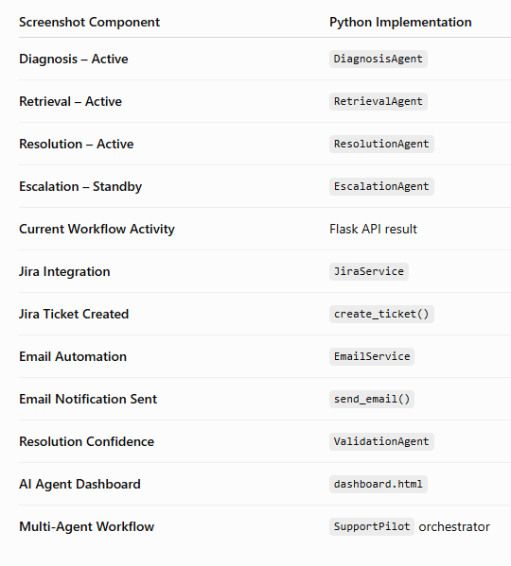
17. Mapping to Your Screenshot

Slide 74
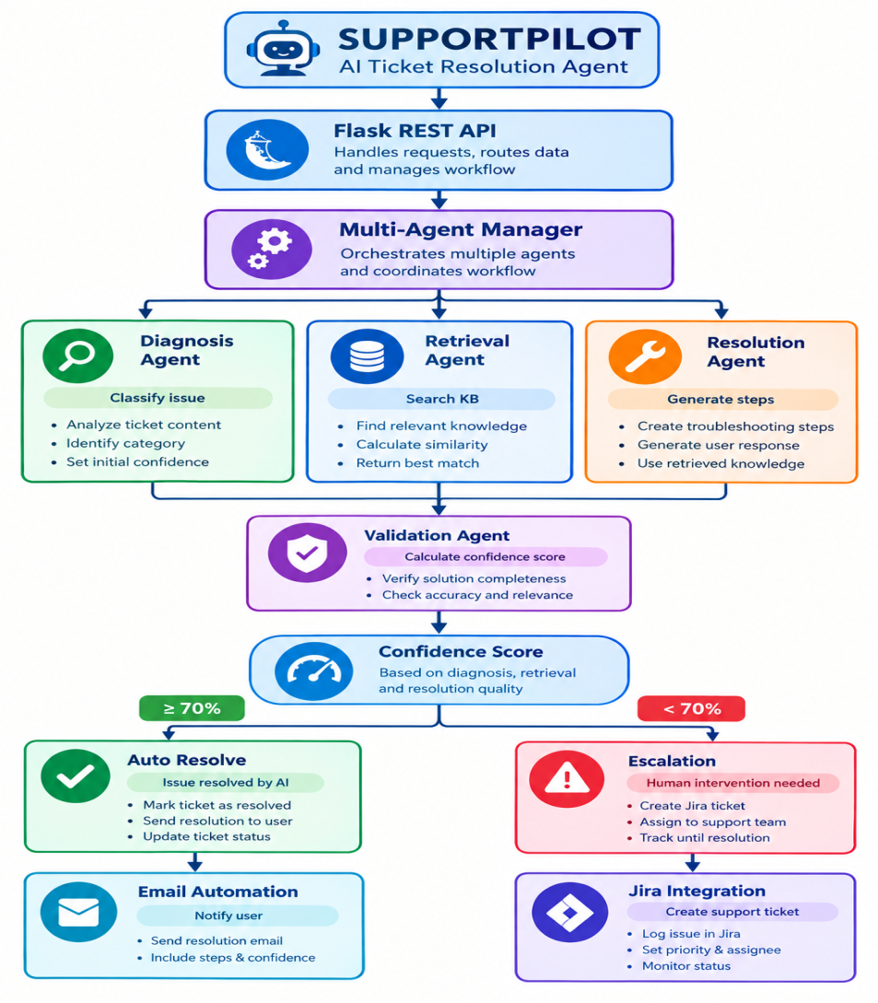
18. Complete Multi-Agent Architecture
The final implementation is:

Slide 75
1. Multi-Agent Architecture
Developed specialized Diagnosis, Retrieval, Resolution, Validation and Escalation agents.
Implemented an orchestrator to coordinate agent execution.
Enabled agents to exchange diagnosis, retrieved knowledge and resolution information.
2. AI Resolution Generator
Generates contextual troubleshooting recommendations.
Produces step-by-step resolution workflows.
Generates automated end-user support responses.
Uses the retrieved knowledge article as contextual information.
3. Resolution Validation
Calculates resolution confidence.
Uses diagnosis confidence, knowledge similarity and resolution completeness.
Automatically resolves high-confidence tickets.
Escalates low-confidence tickets.

Slide 76
4. Jira Integration
Creates Jira tickets for unresolved/low-confidence cases.
Transfers AI diagnosis and troubleshooting information to Jira.
Supports priority-based escalation.
5. Email Automation
Automatically sends resolution instructions to users.
Sends AI-generated support responses.
Provides resolution confidence in the notification.
6. Dashboard
Displays agent status.
Displays workflow activity.
Displays resolution confidence.
Displays Jira and email integration status.

Slide 77
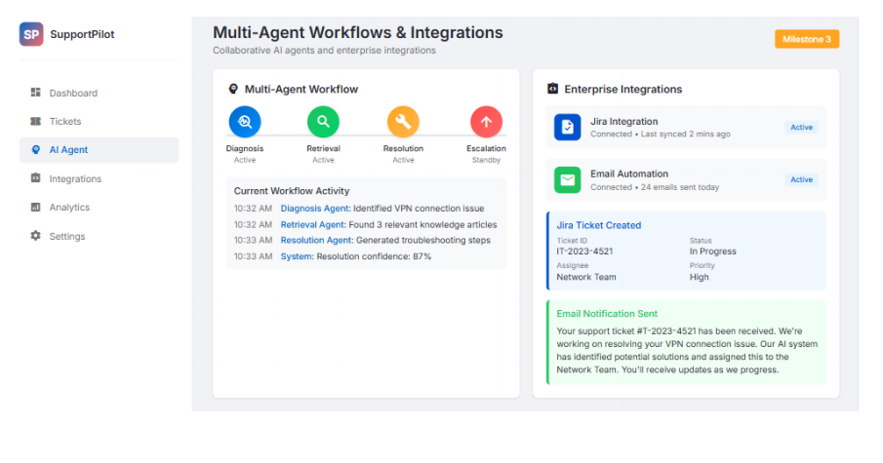

Slide 78
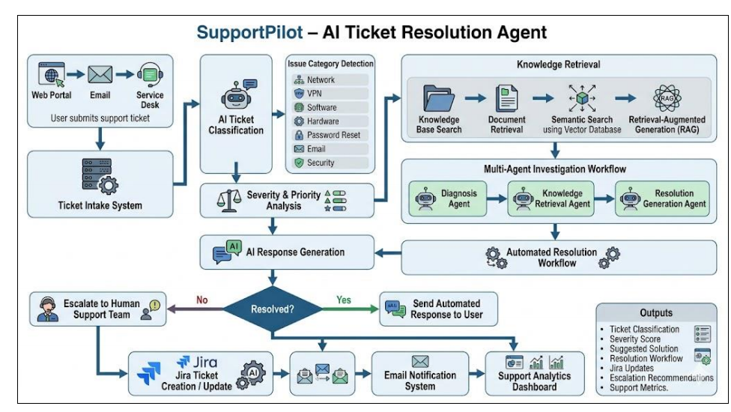
Workflow Diagram

